Slide 1


Slide 2
Relational Algebra
Relational algebra is a procedural query language.
It gives a step by step process to obtain the result of the query. It uses operators to perform queries.
The operators take one or two relations as inputs and produce a new relation as a result.
Relation is a table with columns and rows.

Slide 3
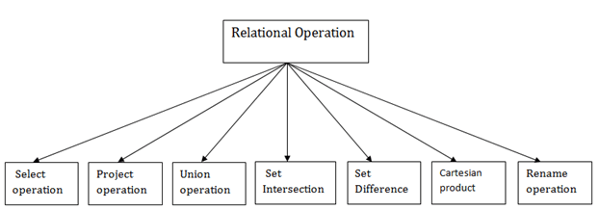
Types of Relational operation

Slide 4
Select , project and rename operations are called unary operations because they operate on one relation
Other operations are called Binary operations because they operate on pair of relations

Slide 5
Select Operation
Select operation selects tuples that satisfies a given predicate (condition)
Notation: σ _{p}(r)
σ is used for selection prediction
p is called the selection predicate, is used as a propositional logic formula which may use connectors like: AND OR and NOT. These relational can use as relational operators like =, ≠, ≥, <, >, ≤.
r is used for relation
Example of selection:
σ _{dept_name=“Physics”}(instructor)

Slide 6

Relation r
σ_{A=B ^ D > 5} (r)
Notes:
The term “Select” corresponds to where in SQL

Slide 7
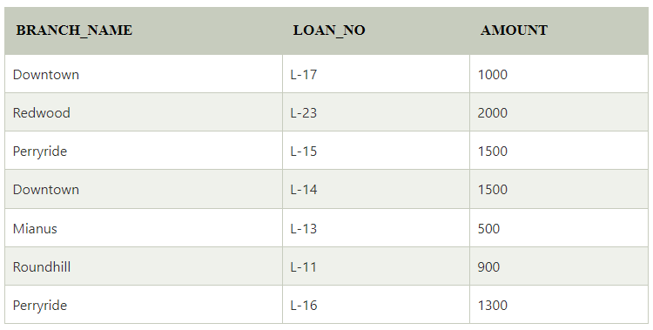
For example: LOAN Relation

Slide 8

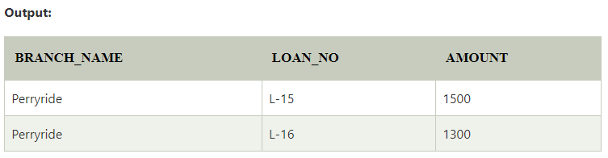

Slide 9
Project Operation
This operation shows the list of those attributes that we wish to appear in the result. Rest of the attributes are eliminated from the table.
It is denoted by ∏.

Slide 10

Project Operation
Notation:
where A₁, A₂ are attribute names and r is a relation name.
Duplicate rows removed from result, since relations are sets
Example: To eliminate the dept_name attribute of instructor
∏_{ID, name, salary} (instructor)

Slide 11
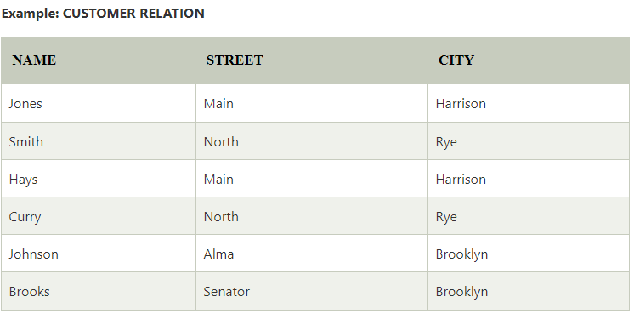

Slide 12

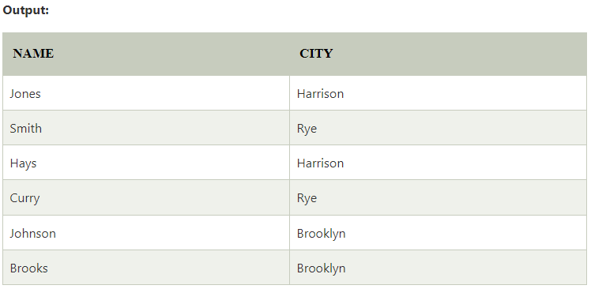

Slide 13

Project Operation – Example
Relation r:
∏_{A,C} (r)

Slide 14
Composition of Relational Operations
Find those customers who live in Harrison?
Πcustomer-name (σcustomer-city =“Harrison” (customer))

Slide 15
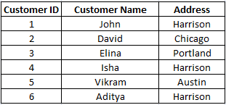
For example: Customer table

Slide 16
Union Operation
Suppose there are two tuples R and S. The union operation contains all the tuples that are either in R or S or both in R & S.
It eliminates the duplicate tuples. It is denoted by ∪.
Notation: R ∪ S
A union operation must hold the following condition:
R and S must have the attribute of the same number.
Duplicate tuples are eliminated automatically.

Slide 17

Union Operation – Example
Relations r, s:
Rules for performing Union:
No. of columns must be same in number in tables
Domain of every column must be same in tables
r ∪ s:

Slide 18
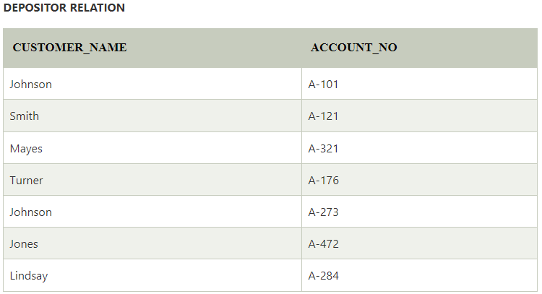

Slide 19
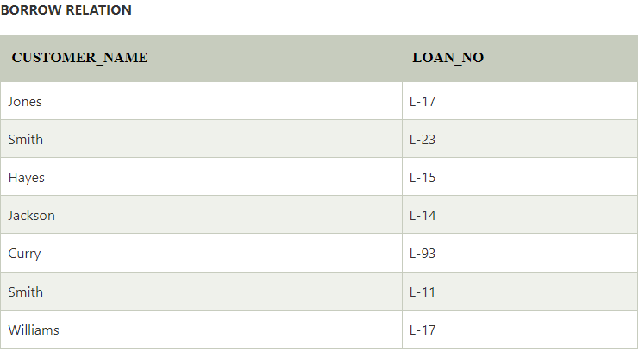

Slide 20
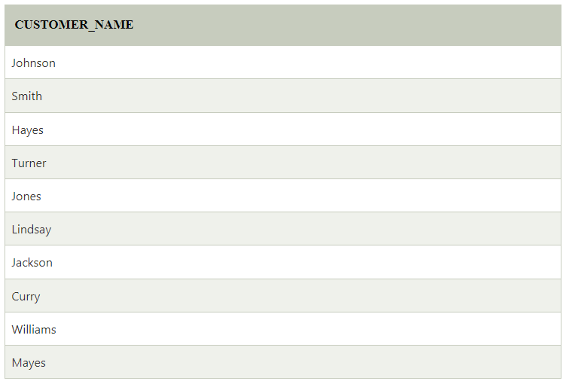

Slide 21

Example

Slide 22
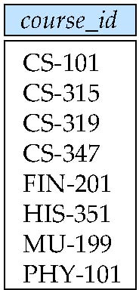
Example
Example: to find all courses taught in the Fall 2009 semester, or in the Spring 2010 semester, or in both
∏_{course_id} (σ _{semester=“Fall” Λ year=2009} (section)) ∪
∏_{course_id} (σ _{semester=“Spring” Λ year=2010} (section))
Since relations are sets duplicate values such
as CS101, which is offered in both semesters are
replaced by a single occurrence.

Slide 23
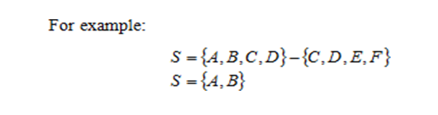
Set Difference Operation
the difference of two sets results in a new set that contains all the elements of first set which are not present in the second set.

Slide 24
Set Difference Operation
Notation r – s
Defined as:
r – s = {t | t ∈ r and t ∉ s}
Set differences must be taken between compatible relations.
  r and s must have the same arity (columns)
  attribute domains of r and s must be compatible
Example: to find all courses taught in the Fall 2009 semester, but not in the Spring 2010 semester
∏_{course_id} (σ _{semester=“Fall” Λ year=2009} (section)) −
∏_{course_id} (σ _{semester=“Spring” Λ year=2010} (section))

Slide 25

Set difference of two relations
Relations r, s:
r – s:

Slide 26

Intersection
Intersection of two sets results in a new set which contains the common elements from both the sets.

Slide 27
Cartesian-Product Operation
Notation r x s
Defined as:
r x s = {t q | t ∈ r and q ∈ s}
Assume that attributes of r(R) and s(S) are disjoint. (That is, R ∩ S = ∅).
If attributes of r(R) and s(S) are not disjoint, then renaming must be used.

Slide 28


Relations r, s:
r x s:

Slide 29

Composition of Operations
Can build expressions using multiple operations
Example: σ_{A=C}(r x s)
r x s
σ_{A=C}(r x s)

Slide 30

Rename Operation (ρ)
The results of relational algebra are also relations but without any name. The rename operation allows us to rename the output relation. 'rename' operation is denoted with small Greek letter rho ρ.
Notation − ρ _{x} (E)
Where the result of expression E is saved with name of x.
We can use the rename operator to rename STUDENT relation to STUDENT1.

Slide 31
Unsafe Expressions
A SAFE EXPRESSION is one that is guaranteed to yield a finite number of tuples as its results. Otherwise, it is called UNSAFE.
E.g. {s.name|¬Supplier(s)
Both TRC and RA has same expressive powers.

Slide 32
Relational Calculus
In contrast to Relational Algebra, Relational Calculus is a non-procedural query language, that is, it tells what to do but never explains how to do it.
Relational calculus exists in two forms −
a) Tuple Relational Calculas
b) Domain Relational Calculas

Slide 33
Tuple Relational Calculas
Filtering variable ranges over tuples
Notation − {T | Condition}
Returns all tuples T that satisfies a condition.
For example −
{ T.name | Author(T) AND T.article = 'database' }
Output − Returns tuples with 'name' from Author who has written article on 'database'.
TRC can be quantified. We can use Existential (∃) and Universal Quantifiers (∀).
For example −
{ R| ∃T ∈ Authors(T.article='database' AND R.name=T.name)} Output − The above query will yield the same result as the previous one.

Slide 34
It is a non-procedural query language which is based on finding a number of tuple variables also known as range variable for which predicate holds true.
It describes the desired information without giving a specific procedure for obtaining that information.
The tuple relational calculus is specified to select the tuples in a relation.
In TRC, filtering variable uses the tuples of a relation. The result of the relation can have one or more tuples.

Slide 35
Domain Relational Calculus (DRC)
In DRC, the filtering variable uses the domain of attributes instead of entire tuple values (as done in TRC, mentioned above).
Notation −
{ a₁, a₂, a₃, ..., a_{n} | P (a₁, a₂, a₃, ... ,a_{n})}
Where a1, a2 are attributes and P stands for formulae built by inner attributes.
For example −
{< article, page, subject > | ∈ KORTH ∧ subject = 'database'}
Output − Yields Article, Page, and Subject from the relation KORTH, where subject is database.

Slide 36
The second form of relation is known as Domain relational calculus. In domain relational calculus, filtering variable uses the domain of attributes. Domain relational calculus uses the same operators as tuple calculus.
It uses logical connectives ∧ (and), ∨ (or) and ┓ (not). It uses Existential (∃) and Universal Quantifiers (∀) to bind the variable. The QBE or Query by example is a query language related to domain relational calculus.

